Slide 1

Another AI Path
Building Genetic Algorithms in C# and .NET

Slide 2

Agenda
What Are Genetic Algorithms?
Why Use Genetic Algorithms with C#?
Building Genetic Algorithms in C#
Optimizing & Extending Genetic Algorithms
Real-World Applications & Best Practices
Q&A & Discussion

Slide 3
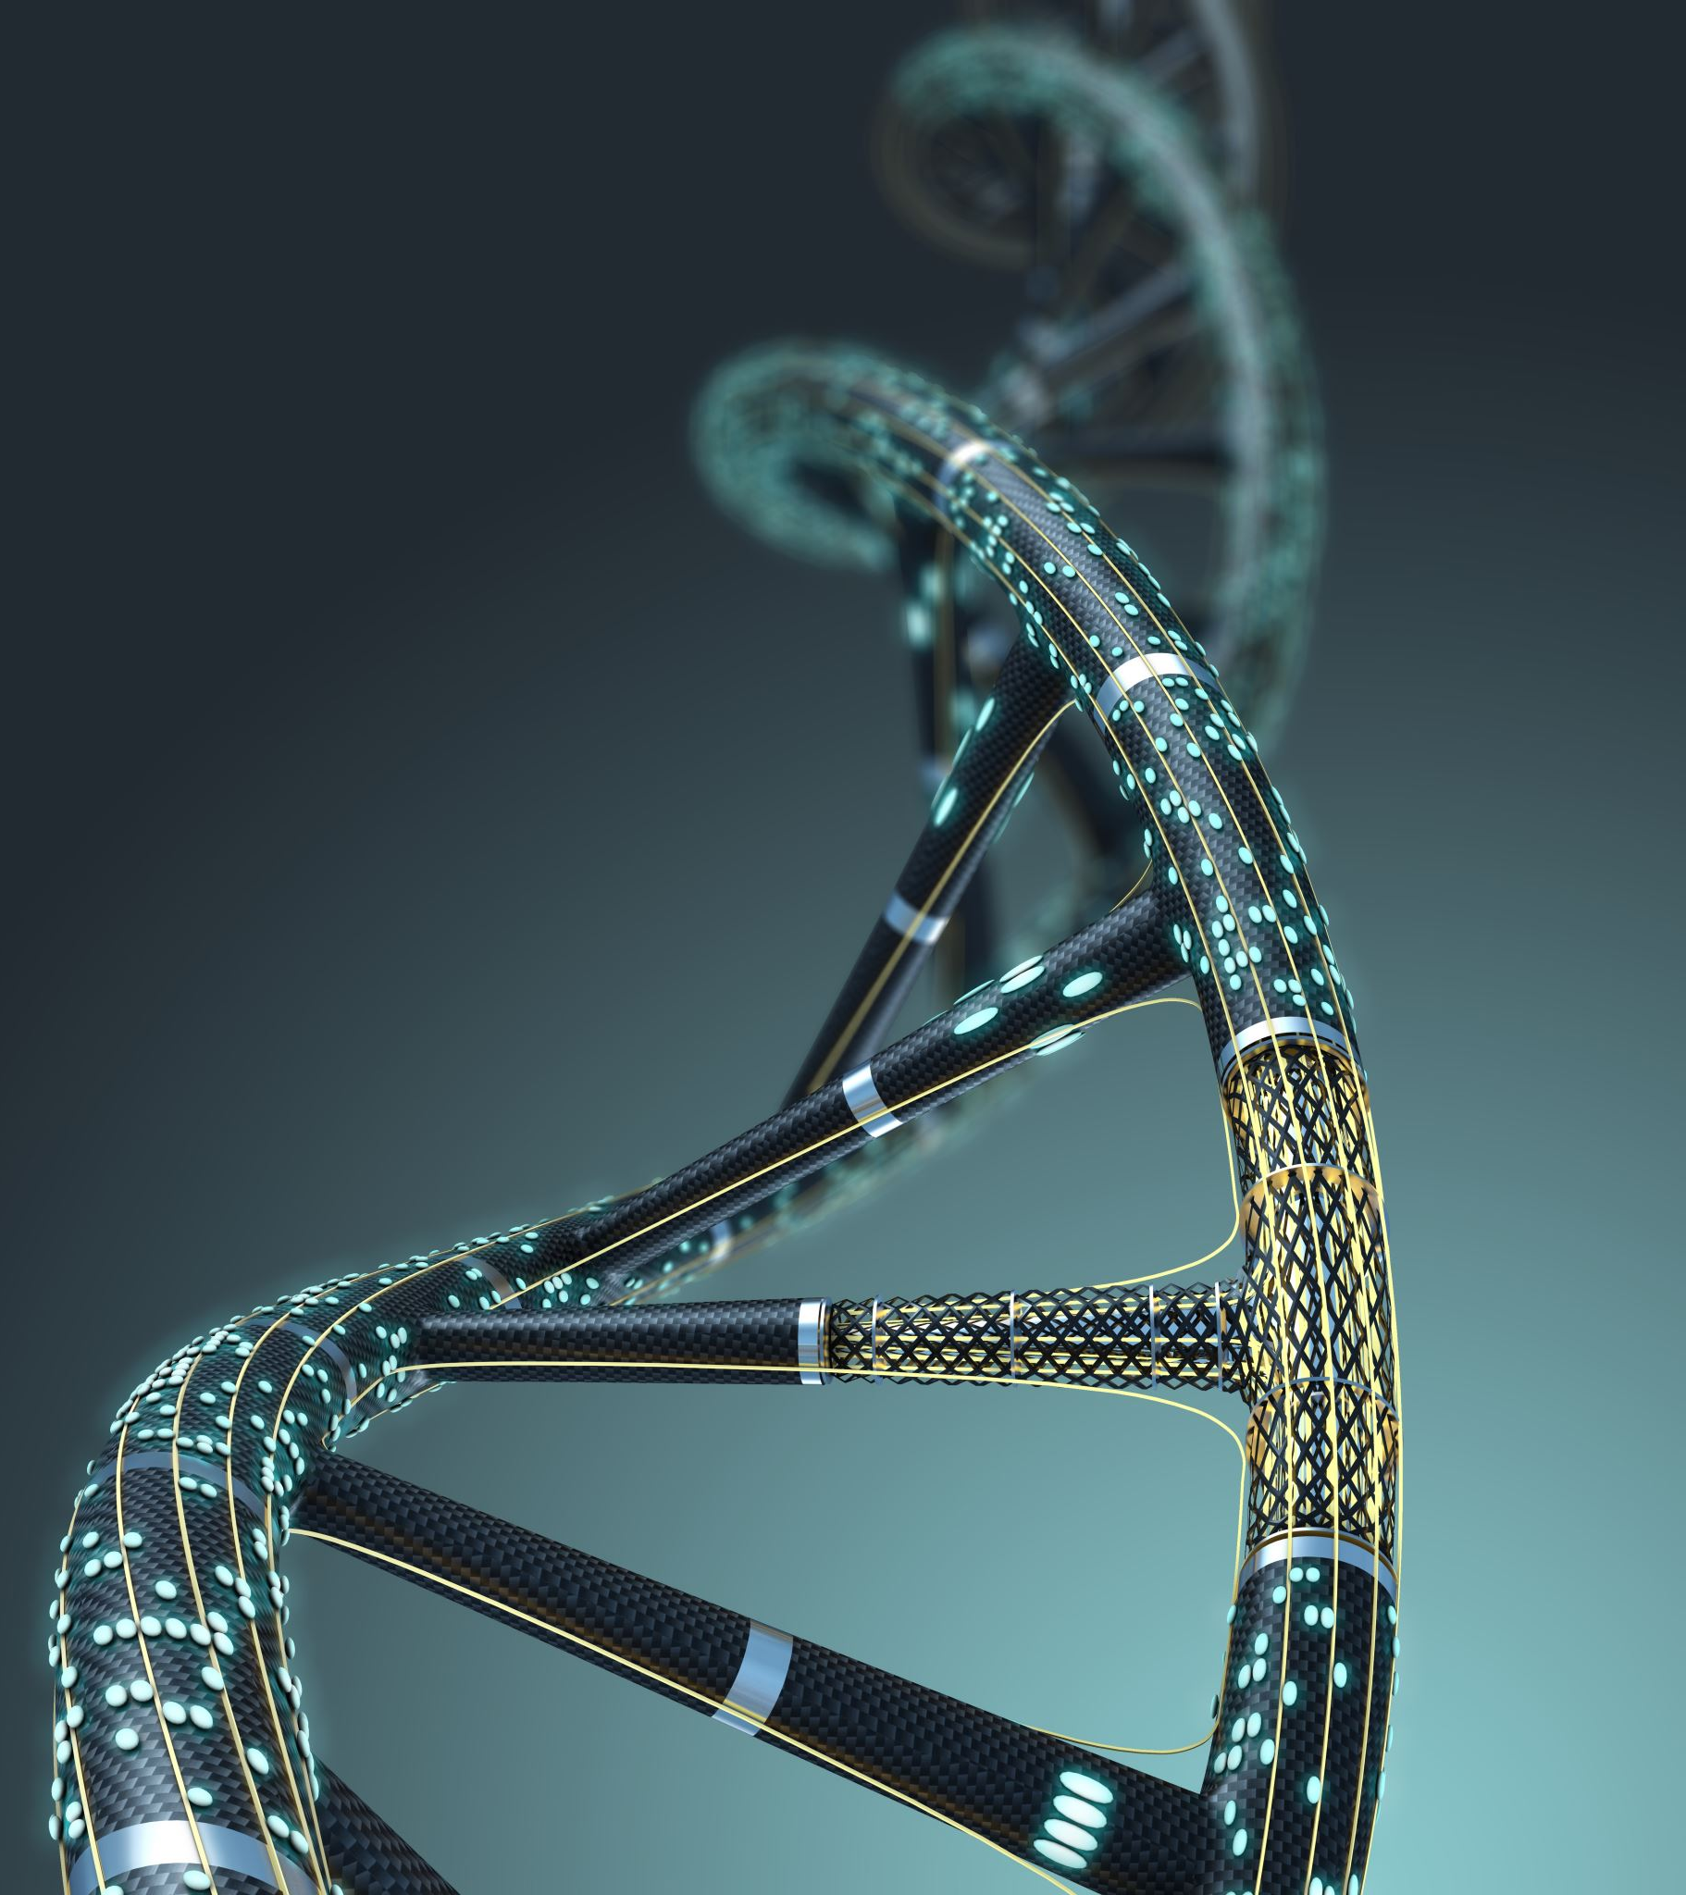
What Are Genetic Algorithms?

Slide 4

Why Use Genetic Algorithms with C#?

Slide 5
Why use genetic algorithms
In computer science an optimization problem is to find the best of all possible or available solutions for a given problem.

Slide 6
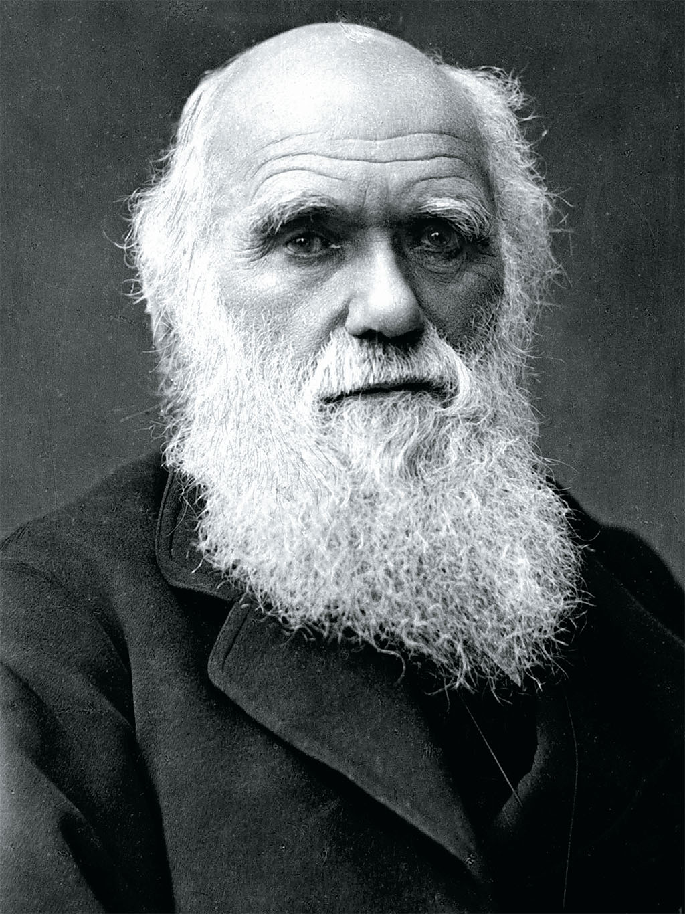
Where did Genetic Algorithms come from?
Evolutionary algorithms are based on biological processes and Darwinian evolution theory. Charles Darwin formulated the scientific theory of evolution by natural selection in his book 'On the Origin of Species', which was published in 1859.

Slide 7
Evolution Overview
Nucleus
Chromosome
Core of a cell
DNA (DeoxyriboNucleic Acid) molecule
Gene
DNA
Small segment of this nucleotide sequence with a specific function
combination of many genes which encode different characteristics of an organism, for example its size, colour and gender

Slide 8
Evolution
Overview
Population
Recombination / Crossover
A group of organisms, in which pairs of members can breed offspring (children)
When two organisms reproduce, their individual chromosomes / DNA will be copied, mixed up and passed on to their children
Mutation
Natural Selection
A few genes of the children will be changed by random chance
The children with the best fitness will survive and reproduce more than other children

Slide 9
Terminology
Gene
Genome
Population
Generation
Smallest unit of information
Sequence of genes
Collection of individual DNAs
A new population of evolved DNA
Selection
Crossover
Mutation
Fitness Function
Objective function which calculates the score of a DNA
A strategy to select parent DNAs for reproduction based on their fitness
A strategy to copy genes from parent DNAs to create new child DNAs
A (random) change of one or more genes in a DNA

Slide 10
Selection

Slide 11
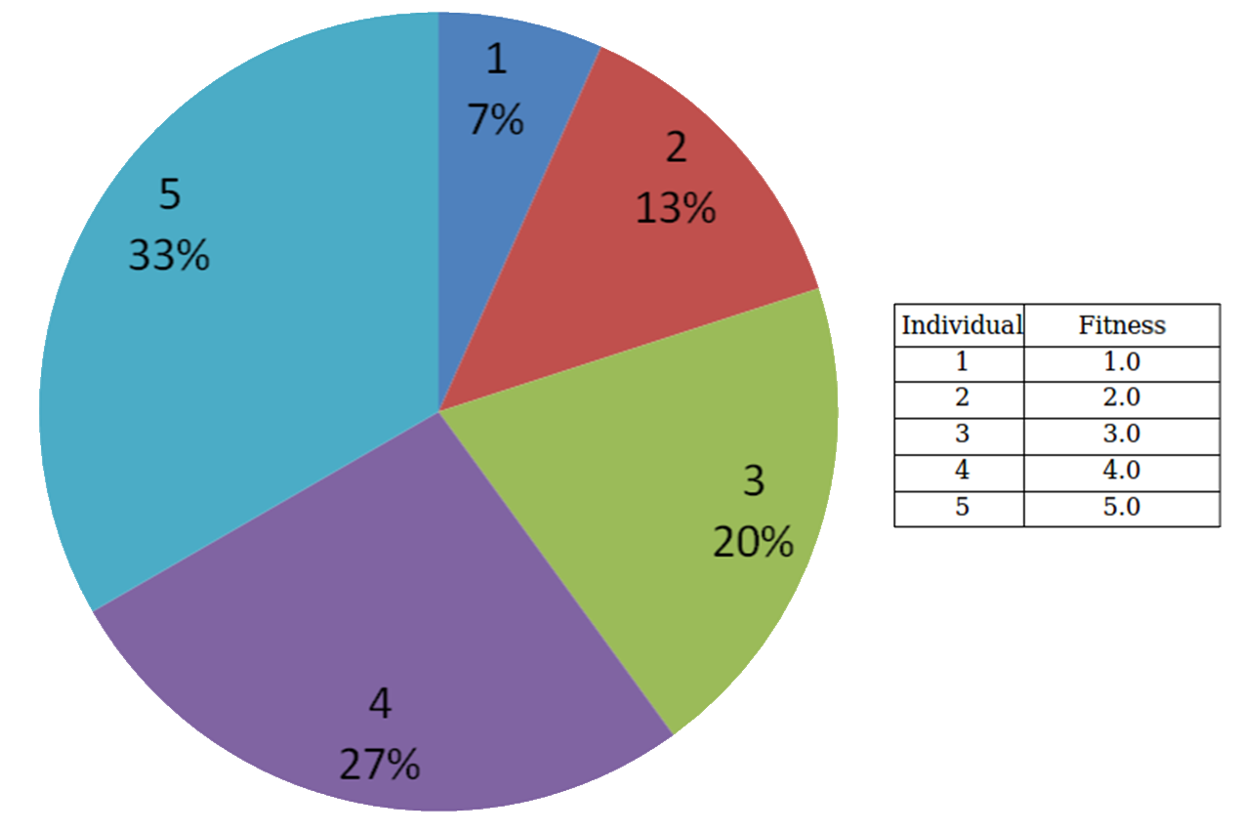
Roulette Selection

Slide 12
Crossover

Slide 13
Mutation

Slide 14
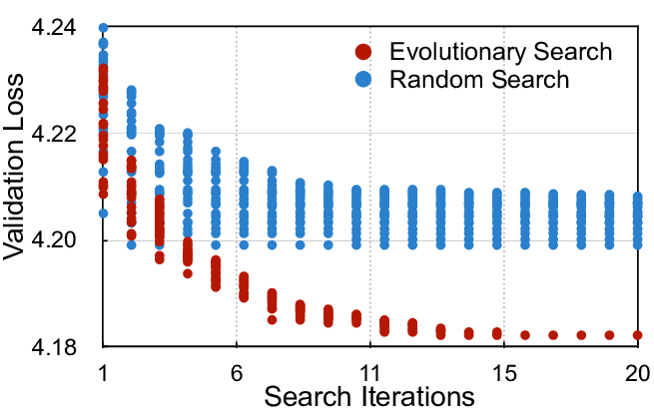
How Quickly Can We Get Results?

Slide 15
Building Genetic Algorithms in C# (Demo)

Slide 16
Fitness Functions for Genetic Algorithms (Demo)

Slide 17
Optimizing & Extending Genetic Algorithms

Slide 18
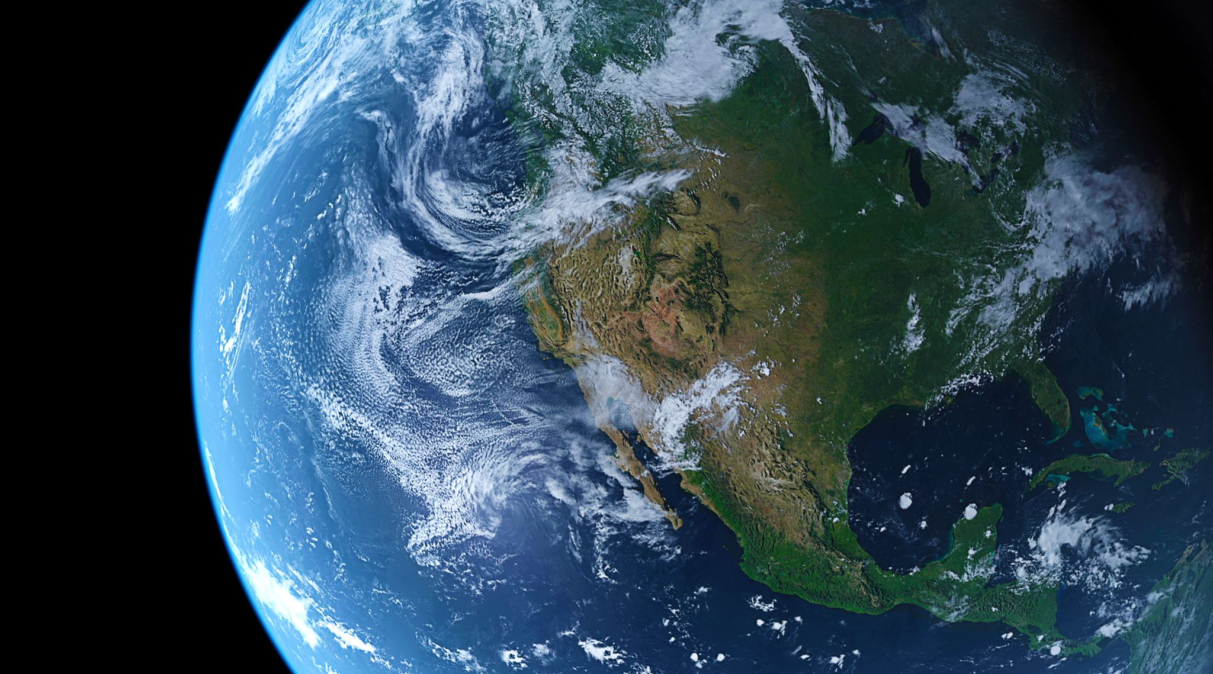
Real-World Applications & Best Practices

Slide 19
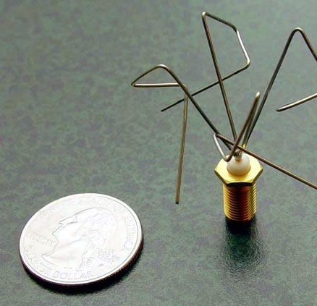
Problems solved by Genetic Algorithms
One example is the design of antennas for radio communication. There is an infinite amount of possible shapes for antennas. In fact, the NASA used Genetic Algorithms to evolve an antenna design for its Space Technology 5 (ST5) mission which launched in March 2006.

Slide 21

Q&A & Discussion

Slide 22
Conclusion about Genetic Algorithms

